Slide 1
Technical Analysis of AUTOSAR

Slide 2
Contents
1. What is AUTOSAR?
2. History of AUTOSAR
3. Structure of AUTOSAR
4. How to use AUTOSAR?
5. AUTOSAR classic platform
6. AUTOSAR adaptive platform

Slide 3
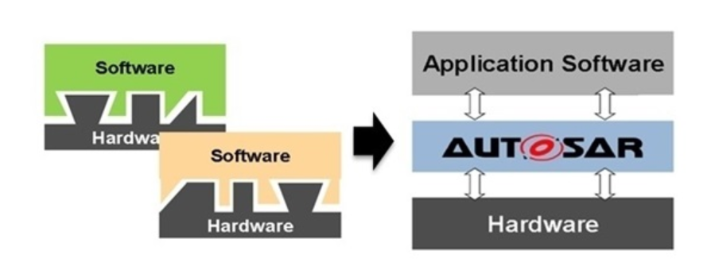
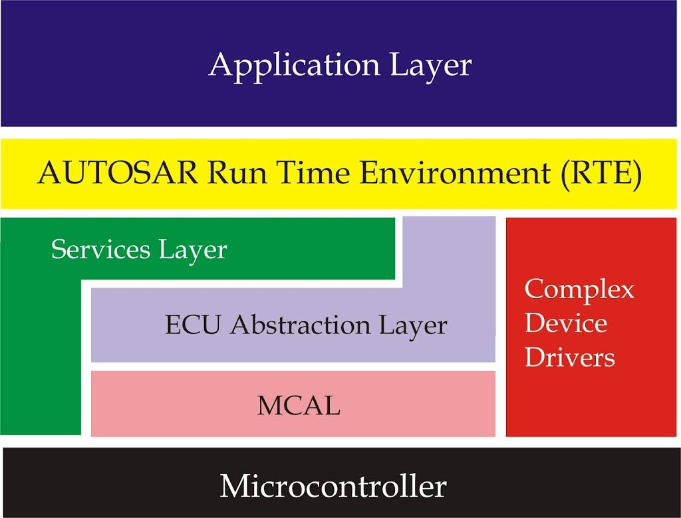

1. What is AUTOSAR?
Remember AUTOSAR is PLATFORM!!!
AUTOSAR = AUTomotive Open System ARchitecture
In the past, every company used each of their own vehicle SW. They are not compatible at all.
It was necessary to make a general platform which can be used at any time. So, they made AUTOSAR.
AUTOSAR is a platform which is available at any time.
Now, Every vehicle company uses AUTOSAR.

Slide 4
Remember AUTOSAR is PLATFORM!!!
1. What is AUTOSAR?
AUTOSAR provides a set of specifications that describe basic software modules, define application interfaces, and build general development methodologies based on standardized exchange formats. The basic software modules provided by the AUTOSAR layered software architecture can be used in automobiles from different manufacturers (OEMs, Manufacturers) and electronic components from multiple suppliers (Suppliers, Tiers) to reduce R&D costs and prepare for the complexity of the growing automotive and electronic software structure. Based on these basic guidelines, AUTOSAR is designed to pave the way for innovative electronic systems that improve performance, safety and environmental friendliness and facilitate software and hardware exchange and update during the service life of the vehicle. It aims to prepare for upcoming technologies and improve cost-effectiveness without compromise on quality.

Slide 5
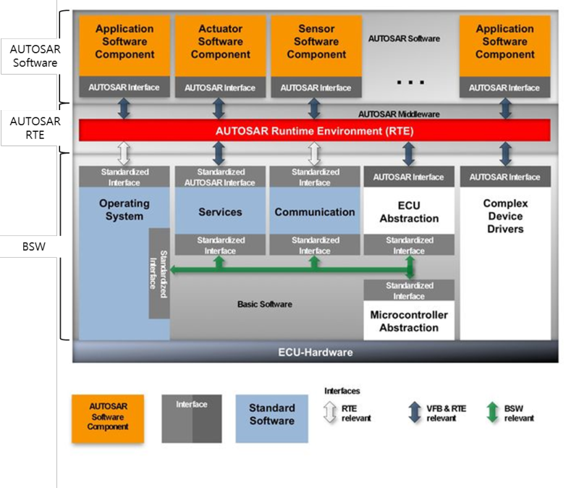

Remember AUTOSAR is PLATFORM!!!

Slide 6
2. History of AUTOSAR
2003 : Started making AUTOSAR classic platform by BMW, Bosch, Continental etc.
2004-2016 : AUTOSAR classic platform`s continuous development and maintenance
2016 : Started making AUTOSAR adaptive platform
2017-current : AUTOSAR adaptive platform`s continuous development and maintenance

Slide 7
3. Structure of AUTOSAR
3 layers are in AUTOSAR
Application layer : Interacting with RTE
RTE(Run Time Environment) : Middleware extracted from network topology for exchange of information between application software components and between underlying software and applications
Basic software(BSW) : A standardized software module that does not have the functional tasks themselves that provide the services required to execute the functional parts of the higher software layer

Slide 8
4. How to use AUTOSAR?
The system configuration description includes all system information and information agreed between different ECUs (e.g. bus signals definition).
ECU extraction : contains information on the system configuration description required for a specific ECU (e.g. a signal accessible by a specific ECU).
ECU Configuration Description: Contains all basic software configuration information limited to a specific ECU. This information can be used to generate executable software, code from the underlying software module, and code from the software components.

Slide 9
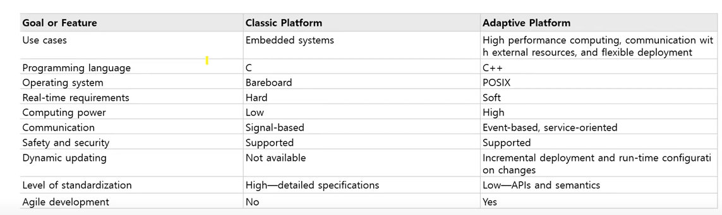
*Overview of “AUTOSAR Classic Platform VS AUTOSAR Adaptive Platform
(Cf) C : Efficient in real-time hard system(e.g. milli seconds, micro seconds) and saving resources
C++ : Only used in high performance computing system. Available in object-oriented programming(e.g. Event-based, sevice-oriented)

Slide 10
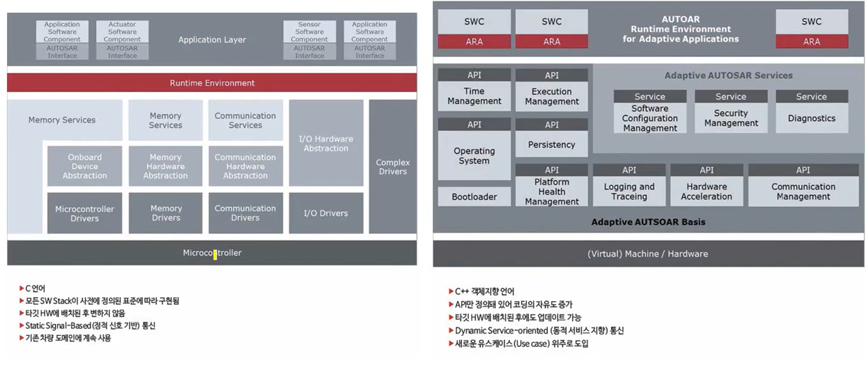
*Overview of “AUTOSAR Classic Platform VS AUTOSAR Adaptive Platform
Classic Platform Adaptive Platform
*Overview of “AUTOSAR Classic Platform VS AUTOSAR Adaptive Platform
Classic Platform : only one RTE which covers everything. Application layer is not connected with BSW(Basic Software) because of RTE
Adaptive Platform : One RTE, Function cluster, Service per each object

Slide 11
*Overview of “AUTOSAR Classic Platform VS AUTOSAR Adaptive Platform
*Summary
Classic AUTOSAR VS Adaptive AUTOSAR
-MCU(Microcontroller) -High performance CPU
-Procedural oriented(C) -Object oriented(C++)
-Low performance HW -High performance HW
-High Real-time -Low Real-time

Slide 12
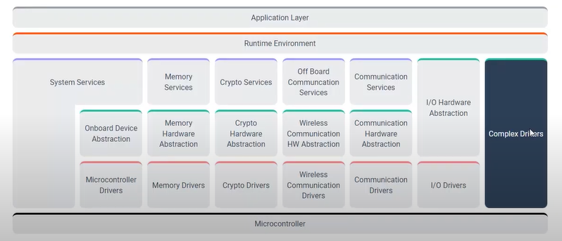
5. AUTOSAR Classic Platform
(1)It is used directly with MCU(HW) unlike adaptive platform which has OS in the middle.
(2)Complex Drivers is the most important part. It not only makes module but also optimize MCU`s low performance.
I.E. It will be very slow to use RTE when using CAN as a signal-based way. But Complex Drivers handles it properly.

Slide 13
5. AUTOSAR Classic Platform
(3) System Service : Very simple OS(e.g. RTOS-Real Time OS).
Complex OS(e.g. Linux, Windows) is only used in adaptive platform
(4)So many drivers are used because Classic platform is used above HW(MCU). And these drivers are used in upper layers abstractly

Slide 14
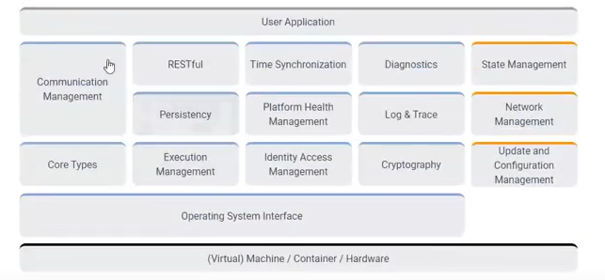
6. AUTOSAR Adaptive Platform
-Interface : Service, API
-Implements ARA(Autosar Runtime for Adaptive Application)
-Consists of functional clusters
-Unlike Classic platform, adaptive platform dynamically links services and clients during runtime

Slide 15
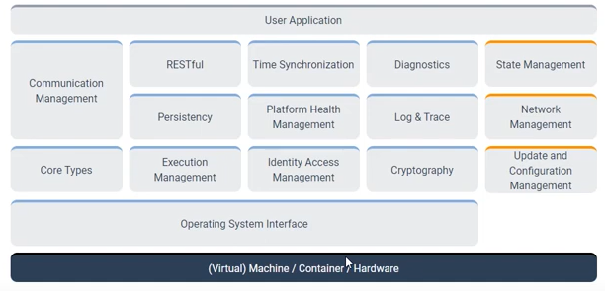


6. AUTOSAR Adaptive Platform
-Foundation Function Cluster

Slide 16
6. AUTOSAR Adaptive Platform
*Foundation Function Cluster
-Core Types : Defined types of parameter for ARA
-Execution Management : Managing execution of function clusters and process(application)
-Persistency : File i/o control
-RESTful : hypertext, http etc.
-Time Synchronization : Time setting, Time Synchronizing
-Platform Health Management : Detect errors of Application, system
-Identity Access Management : Checking execution authorization
-Cryptography : Security service (encryption, decryption)
-Log & Trace : Provide DLT library
-Diagnostics : Protocol for transferring and processing data

Slide 17
6. AUTOSAR Adaptive Platform
-Foundation Function Cluster
*Execution management(Very important)
It seems that OS and EM has the same function.
But why are we still using EM and OS at the same time?
EM separates OS with platform.
When developing process(application), it does not need to care about OS(OS와의 응집도는 up, 결합도는 down)
Therefore, EM is an interface that connects OS/HW with platform.
With using EM, you can directly replace OS/HW or Platform and also it makes any OS(e.g. Linux, Windows) be capable
Cf. EM is not in Classic platform but only in the Adaptive platform

Slide 18
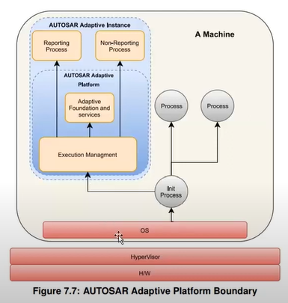
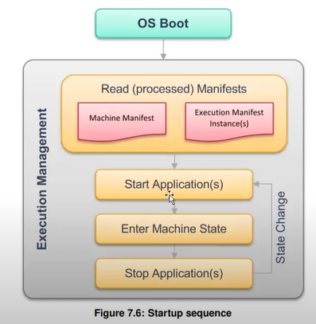
6. AUTOSAR Adaptive Platform
-Foundation Function Cluster
*Execution management(Very important)
(2) EM has it`s own “Requirements of EM” and “Specification of EM“. You can find it easily on website.
(3) Startup sequence of EM

Slide 19
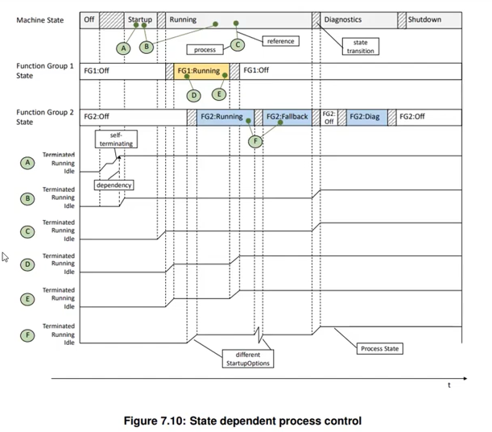
6. AUTOSAR Adaptive Platform
-Foundation Function Cluster
*Execution management
A, B, C, D, E, F : Process
A : initializing process-Self termination
B : A dependency
C : Machine State running
D, E : FG1 State running
F : FG2 State running and fallback
FGs are operating parallelly which lead parallel processing of process

Slide 20
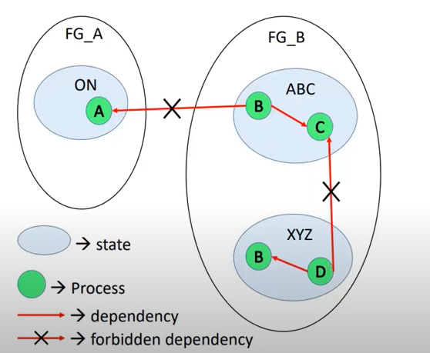
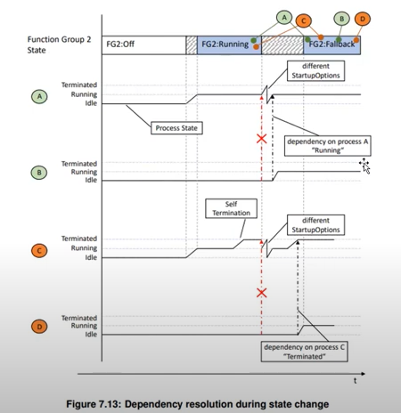
6. AUTOSAR Adaptive Platform
-Foundation Function Cluster
*Caution
FGs and states can not depend
with each other if they are
not in the same FG or state

Slide 21
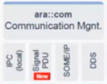
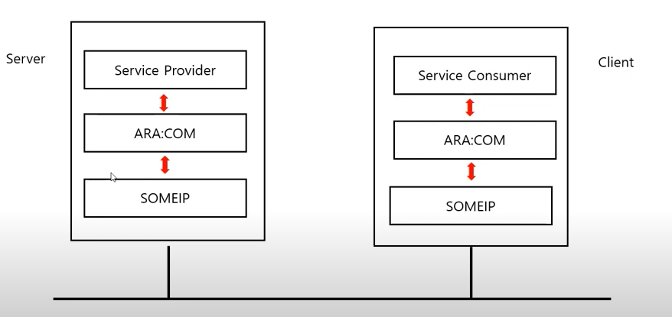
6. AUTOSAR Adaptive Platform
-Foundation Function Cluster
*Communication management
(Very important)
ECU`s communication(e.g. CAN, FlexRay) handling by using SOMEIP

Slide 22
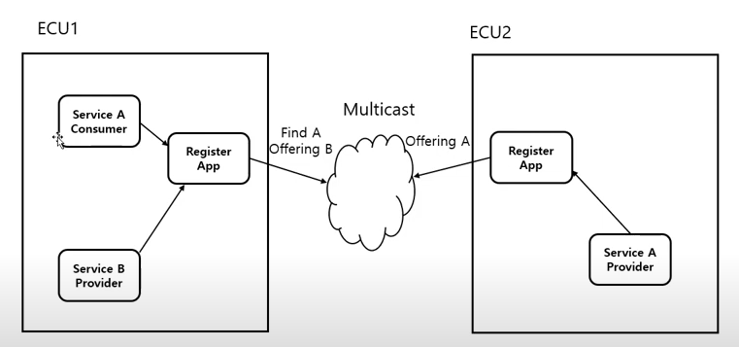
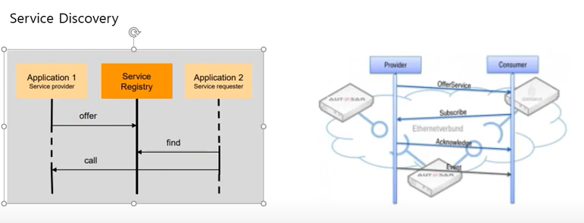
6. AUTOSAR Adaptive Platform
-Foundation Function Cluster
*SOMEIP
Every ECU has its own Registry and SOMEIP is done by multicasting

Slide 23

6. AUTOSAR Adaptive Platform
-Service Function Cluster

Slide 24
6. AUTOSAR Adaptive Platform
*Service Function Cluster
-Network management : Managing PN(Partial Network, used in AUTOSAR), VN(Virtual Network, used in other communication systems)
-State management : Managing states of applications
-Update and Configuration management : Continuous update of platform

